Slide 2

INCEDO HACKATHON
February 2, 2018
Proprietary & Confidential

Slide 3

Team
Sr.No. | Team Member | SAP ID | Email-id
1 | Jayant Singh | 600522 | jayant.singh@incedoinc.com
2 | Amit Bhatt | 186491 | amit.k50@incedoinc.com
3 | Vikas Nagpal | 192091 | nagpal.vikas@incedoinc.com
4 | Rajesh Awasthi | 600718 | rajesh.awasthi@incedoinc.com
5 | Harish Rawat | 602319 | harish.rawat@incedoinc.com
Notes:
These more or less interdependent subfields consist of drug manufacturers, drug marketers, and biotechnology companies.
The pharmaceutical industry has made a great deal of progress over the last decade due to a research-oriented approach that has improved technologies, developed infrastructures, and increased research in the field of bioscience. Thanks to biotechnology, various formulations have been developed to cure or stop the growth of several major infections, including HIV and certain types of cancer.

Slide 4
Business Need
The use for the Solution is derived from the challenges faced by the delivery team in meeting the expectations of the business users.
Pharma commercial is purely data driven and has lot of data analysis needs it requires lot of reports and dashboards to be prepared on need basis just for analyzing a particular problem.
Business team has lot of ad-hoc BI requirements for formulation of strategy/ operational improvements.
Historically, data analysis platforms were not very good at this. Data typically had to be aggregated as it came in, and to do that you had to have decided your business questions in advance.
Normally 20%-30% of the delivery team bandwidth choked in such requests. High time pressure also results in erroneous reports/ compromise on quality by the delivery team.
The team has designed this solution to meet the ad-hoc analysis requirement on time with quality.
INC-2, Ver. 1.0

Slide 5
Solution
Analyzer dashboards is specifically designed to facilitate ad hoc analysis by providing quick, easy access to data from the original report.
Allowing the user (typically a business user) access to data through a point-and-click interface eliminates the need to request data and analysis from another group within the company.
This capability allows for quicker response times when a business question comes up, which in turn should help the user respond to issues and make business decisions faster.
Our Ad hoc analyzer can be used to create a report that does not already exist, or drill deeper into a static report to get details about accounts, transactions, or records.
The key features:
Data Analysis on the fly- No Technical skills required
Drag and drop (Facts & Dimension) feature to create new report
Export report with Raw data ( in PPT, PDF and Excel format)
As part of the Incedo Hackathon the team will develop a Data cube and provide a dashboard to create ad-hoc report. The dashboard will support drag and drop feature for easy ad-hoc analysis.
INC-2, Ver. 1.0

Slide 6
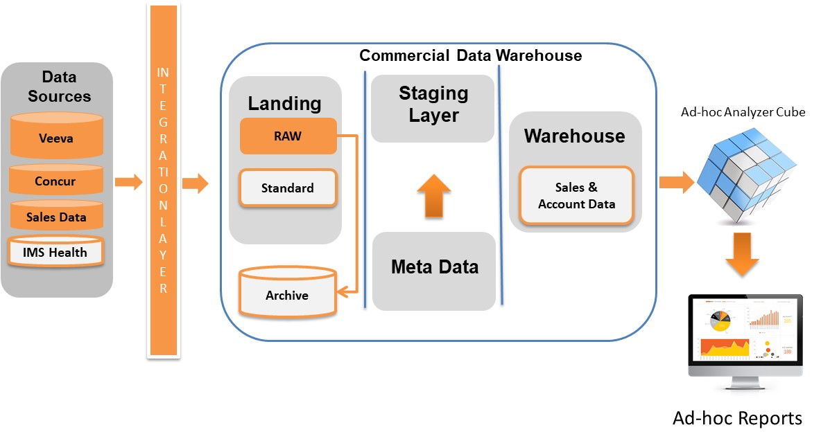
High Level Process Flow
INC-2, Ver. 1.0

Slide 7
Business Need
The use for the Solution is derived from the challenges faced by the delivery team in meeting the expectations of the business users.
Pharma commercial is purely data driven and has lot of data analysis needs it requires lot of reports and dashboards to be prepared on need basis just for analyzing a particular problem.
Business team has lot of ad-hoc BI requirements for formulation of strategy/ operational improvements.
Historically, data analysis platforms were not very good at this. Data typically had to be aggregated as it came in, and to do that you had to have decided your business questions in advance.
Normally 20%-30% of the delivery team bandwidth choked in such requests. High time pressure also results in erroneous reports/ compromise on quality by the delivery team.
The team has designed this solution to meet the ad-hoc analysis requirement on time with quality.
INC-2, Ver. 1.0

Slide 8
Why Ad-hoc Analyzer
A domain Agnostic solution
Technology Agnostic- Can be designed as a Big Data solution for industries having high data volume with real time data churn and with variety of data
Allowing the user (typically a business user) access to data through a point-and-click interface eliminates the need to request data and analysis from another group within the company.
Quicker response time for business user- make business decisions faster.
INC-2, Ver. 1.0

Slide 9
Thank You
INC-2, Ver. 1.0

